Slide 1
Driver Module Framework (DMF)
Sam Tertzakian and Rajesh Gururaj
Principal/Senior Software Engineers
Notes:
Hello everyone.
Thank for attending the last session of the last day. My name is Sam.

Slide 2

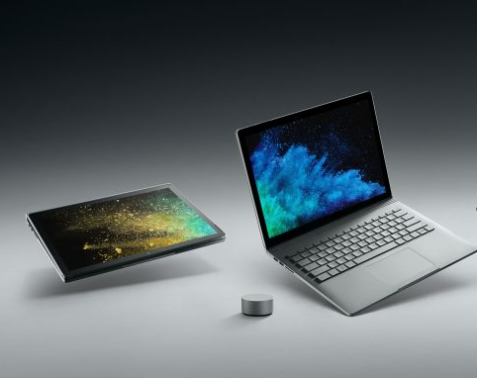
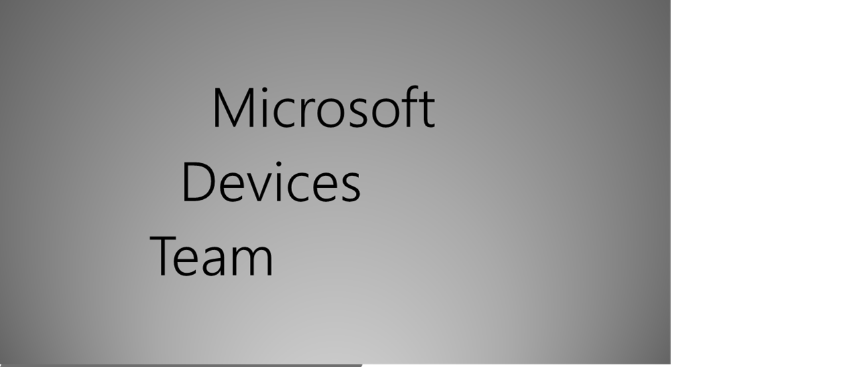

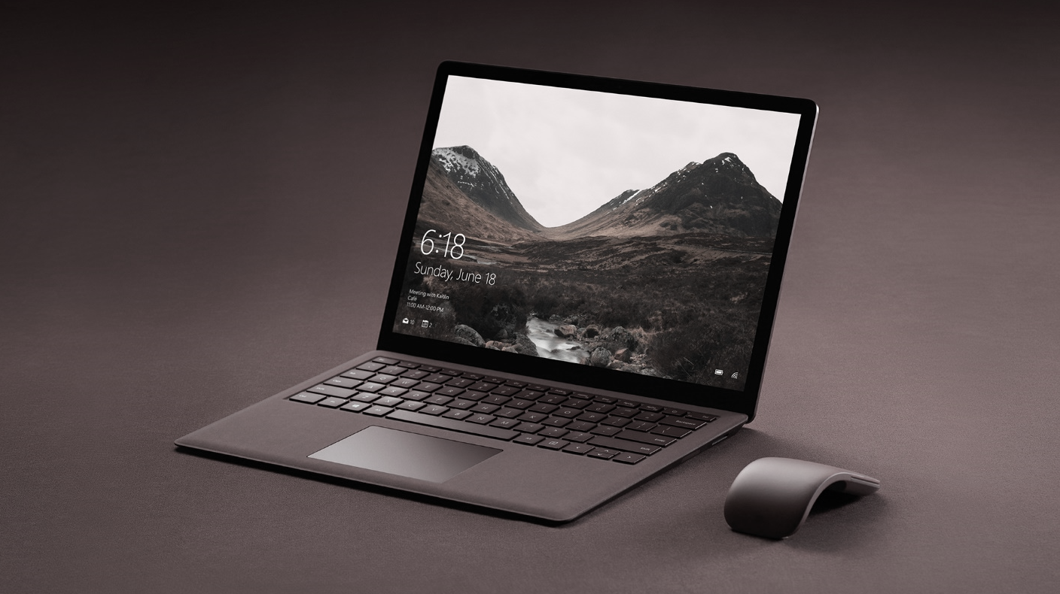
Notes:
The first device driver I wrote was for Windows NT 3.51 and I have been writing device drivers since then.
Like many of you, Microsoft Devices team writes drivers many for multiple products with aggressive schedules.
We needed to find a way to write better drivers more efficiently. To that end we created Driver Module Framework.
It did help us write better drivers more efficiently.
We believe it can help the Windows device driver community so we have released it as open source.
I am here to introduce it to you!

Slide 3
Introduction and Agenda
Session Goals
Introduction to DMF and Explanation of Core DMF Concepts
Session Agenda:
Part 1: Summary of WinHEC talk, Overview of GitHub site, Clone and Compile DMF and Samples.
Part 2: Modules and Libraries, Steps to Create a Module and Library from scratch, Protocol/Transport Feature
Part 3: Review of Modules in Library and View of Surface Library
Part 4: Reviews of Surface Drivers
Notes:
In this session, I will explain DMF and the goals it achieves.
I will discuss the traditional driver model and how it can be improved. Then, in the quest to improve driver writing practices, I will introduce the DMFMODULE and DMF Core.
Next, I will discuss some of the Modules released with DMF.
I will discuss how to use DMF in drivers and show sample source code.
I will discuss our plans with DMF going forward and show you where you can get DMF.
Everything I talk about today, including DMF itself, the Modules, and sample code are all available as source on Git hub and you can download it now.

Slide 4
Part 1
Section Introduction
What is DMF and what are its goals?
Section Agenda:
Traditional driver diagram and discussion
Introduce DMFMODULE and DMF Core
DMF driver diagram and discussion
Modules discussion
How to make a DMF driver?
Look at sample source code
DMF Resources and Overview of GitHub site
Clone Repository and Build DMF and Samples
Notes:
In this session, I will explain DMF and the goals it achieves.
I will discuss the traditional driver model and how it can be improved. Then, in the quest to improve driver writing practices, I will introduce the DMFMODULE and DMF Core.
Next, I will discuss some of the Modules released with DMF.
I will discuss how to use DMF in drivers and show sample source code.
I will discuss our plans with DMF going forward and show you where you can get DMF.
Everything I talk about today, including DMF itself, the Modules, and sample code are all available as source on Git hub and you can download it now.

Slide 5
What is DMF and what are its goals?
Framework that makes it easier to write better drivers
“DMF Drivers” are “WDF Drivers”. Programmers use WDF and DMF together.
Goals
Make it easier and more intuitive to write modular, layered code inside drivers.
Make it possible to directly reuse (by linking) driver code without using “copy/paste/modify”.
Make it easier to properly architect drivers by eliminating improper dependencies and code paths.
Make it easier for driver writers to think using high-level constructs.
Make it easier for driver writers to create their own high-level constructs and let others reuse them.
Make driver programming easier, faster, cheaper and more satisfying.
Result when the above goals are met:
Programmers spend more time thinking, writing and debugging new code that accomplishes their specific requirements and less time writing code that has been written many times before.
Notes:
DMF is a framework that makes it easier to write better drivers.
Dmf drivers are Wdf drivers. Programmers use WDF and DMF together.
The goals of DMF are:
1. Help driver programmers write modular, layered code and re-use code without using “copy/paste/modify”.
2. Help driver programmers properly architect drivers by eliminating improper dependencies and code paths.
3. Make it easier for driver programmers to think using high-level constructs and to create their own high-level constructs which others can re-use.
4. Finally, the main goal is to make driver programming easier, faster, cheaper and more satisfying.
If we achieve those goals, then programmers spend more time thinking, writing and debugging new code that accomplishes their specific requirements and less time writing code that has been written many times before

Slide 6
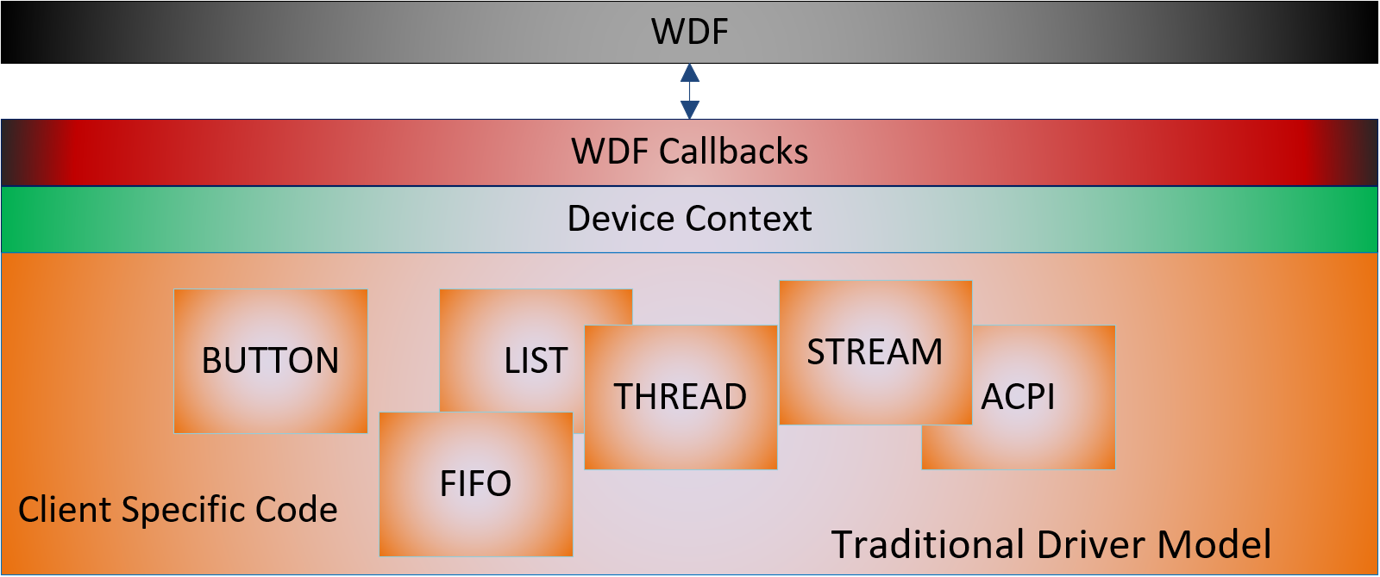
Traditional Driver Diagram
Notes:
Here is the traditional driver model we are all familiar with.
WDF calls into the driver via callbacks.
The driver then calls into modules passing the Device Context.
The biggest problem with this model is that each Module is not self contained. For example, Button may be dependent on FIFO and ACPI. Thus, if we want to reuse Button, we need to copy code from three modules.
Another issue is that from this diagram, we can guess which modules communicate with each other. But we don’t know for sure.
Finally, one of the biggest problems is that the modules do not handle WDF callbacks directly.
They rely on the Client driver to send them messages. These issues make the code in this driver difficult to re-use and affects the efficiency of teams that write device drivers.

Slide 7
C++ helps…but still needs “glue”
NTSTATUS MyDriver_D0Entry(…) {
DEVICE_CONTEXT* deviceContext=DeviceContextGet(Device);
deviceContext->Button.D0Entry(deviceContext);
deviceContext->Thread.D0Entry(deviceContext);
/*… some other code */
deviceContext-> Stream.D0Entry(deviceContext);
}
Notes:
Many of the issues described in the previous diagram can be solved with C++ or other object-oriented programming methods. C++ helps by allowing us to modularize code but does not solve all the problems.
The objects are still not totally self-contained. The Client driver must still call the correct callback of each object when the Client driver receives callbacks.
While we are using an object-oriented language, we are not doing true object-oriented programming.
What if Button() does not need to be called at D0Entry() but a child object of Button needs to be called?
Using the method on this slide, the Client driver needs to know what is happening inside each object…and then make sure that proper action is taken. We need a better solution.

Slide 8
Traditional Driver Diagram
Notes:
What will help us is if somehow Button’s D0Entry() gets called directly by WDF without Client driver intervention. Not only that…children of Button that support D0Entry() must also called by WDF.
We have seen that using C++ itself is not a solution, but we have found a huge clue about how to proceed in our quest to write better drivers: The answer to our quest probably lies in a true object-oriented design.

Slide 9
Traditional Driver Diagram
Notes:
This is good news. If we are able to incorporate true object-oriented design into drivers, then many useful attributes come for free:
Reusability,
Data hiding,
Inheritance,
Modular, layered code,
Objects related by strict parent child relationships
And other goodness provided by object-oriented programming.

Slide 10
Introduction to DMF
DMFMODULE
DMF Core
Notes:
Keep in mind the problems I described...
Let me introduce you to two new concepts: DMFMODULE and DMF Core

Slide 11
DMF Module (DMFMODULE)
ModulePrepareHardware
ModuleReleaseHardware
ModuleD0Entry
ModuleD0EntryPostInterruptsEnabled
ModuleD0ExitPreInterruptsDisabled
ModuleD0Exit
ModuleDeviceIoControl
ModuleInternalDeviceIoControl
ModuleSelfManagedIoCleanup
ModuleSelfManagedIoFlush
ModuleSelfManagedIoInit
ModuleSelfManagedIoSuspend
ModuleSelfManagedIoRestart
ModuleSurpriseRemoval
ModuleQueryRemove
ModuleQueryStop
ModuleRelationsQuery
ModuleUsageNotificationEx
ModuleArmWakeFromS0
ModuleWakeFromS0Triggered
ModuleArmWakeFromSxWithReason
ModuleDisarmWakeFromSx
ModuleWakeFromSxTriggered
ModuleFileCreate
ModuleFileCleanup
ModuleFileClose
ModuleQueueIoRead
ModuleQueueIoWrite
WDFOBJECT
Private Context
Private Methods
Create Function (Constructor)
Public Methods
CONFIG structure and CONFIG_INIT() function
DMFMODULE
WDF Callbacks
Notes:
Let me introduce DMFMODULE. A DMFMODULE is a WDFOBJECT. It has all the same elements that one might expect in a WDFOBJECT. But, a DMFMDOULE has an additional component: WDF callbacks. With these callbacks, a DMFMODULE author can now write code to handle any WDF callback and it is part of the Module itself. This is a step forward to better object-oriented code but it is not the entire solution. For all intents and purposes, this just a C++ object that has WDF callbacks. The Client driver must still call those WDF callbacks.

Slide 12
DMF Core
The DMF Core is a framework is statically linked to the Client driver.
It resides between the Client driver and WDF.
The Client driver gives DMF Core a list of each DMFMODULE it wants to use.
When WDF calls into the Client driver via a callback, DMF dispatches the callback to every DMFMODULE it has created on behalf of the Client.
Notes:
Let me introduce you to the DMF Core.

Slide 13
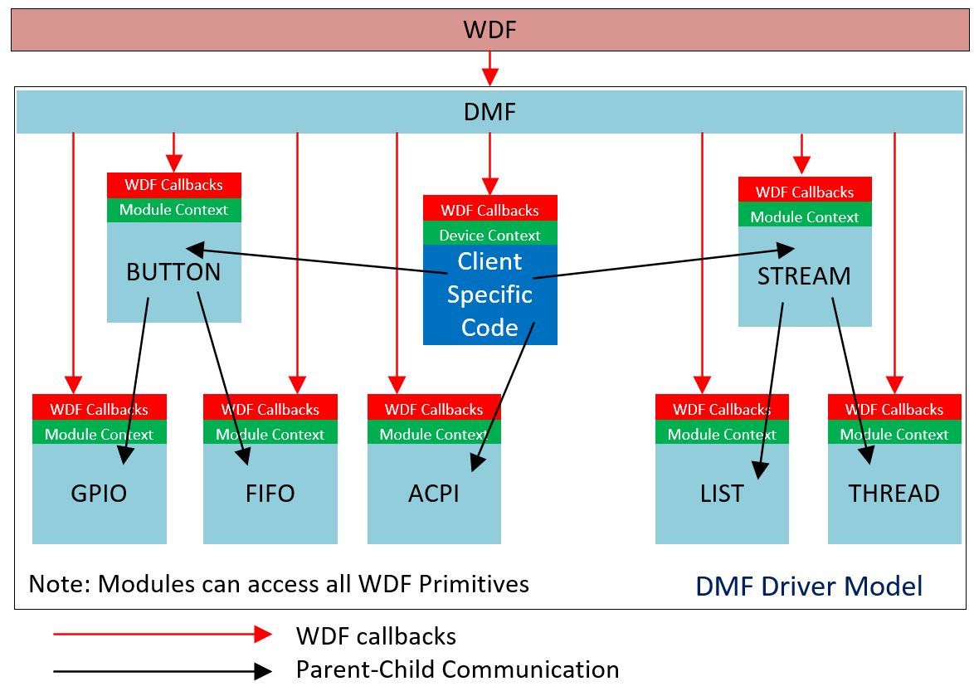
DMF Driver Diagram
Goal: Make it easier to properly architect drivers by eliminating improper dependencies and code paths.
Notes:
0. DMF core between WDF and the Client driver.
The DMFMODULEs are in light blue. The Client specific code is in dark blue.
The red arrows show how DMF dispatches WDF callbacks directly to each DMFMODULE and its child Modules without knowledge of other Modules or the Client driver.
The black arrows show the possible communication between Modules. Unlike the previous diagram, we know FOR SURE that Thread cannot access GPIO. Client Specific Code cannot access FIFO.
Client specific code created 3 Modules, Button Acpi and Stream. Those are the only Modules it cares about and can communicate with.

Slide 14
DMF Driver Diagram
Goal: Make it easier to properly architect drivers by eliminating improper dependencies and code paths.
Notes:
We have made a great leap forward our goal of pure object-oriented code inside of device drivers.
Note that by simply adding the ability for WDF backs to be called automatically, we gain all the goodness of pure object-oriented code.

Slide 15
Other Properties of a Module (1)
Any Module can instantiate as many instances of other Modules as Child Modules as it wants. There is no limit to the number of descendants or siblings a Module can have (except for memory).
Programmers can use Modules and create new Modules.
When a programmer creates a new DMFMODULE, DMF automatically creates the DMFMODULE using an underlying WDFOBJECT.
A Module’s functionality is always accessed using a handle that is created by DMF and given to the Client.
Internally, the Module uses its handle to retrieve its private context. This is similar to how a driver uses its WDFDEVICE to access its device context.

Slide 16
Other Properties of a Module (2)
As with any object-oriented programming paradigm, Modules are agnostic about their parent which can be either the Client Driver or another Module.
DMF Modules can abstract any kind of code, from simple object like a list of buffers to an entire algorithm, data structure, programming pattern and even a full device driver.
Important: Like WDF, DMF’s interfaces to the Client driver are in C. Like WDF, DMF can also be used in C++ drivers.

Slide 17
DMF Driver Diagram
Notes:
Some of you may have noticed that the dark blue box looks very similar to all the other Modules. It has WDF callbacks and a private context (the device context). It can only communicate with the Modules it instantiated. I just said that any driver can be written as a Module. And it is clear from this diagram that it is the case.
You might be asking, “Sam, just because I can make a driver into a Module does not mean I should! Why would I want a function driver to be a Module? Who would reuse it?” My reply is:….”You lose nothing by making your driver Module. But you gain one very important attribute: It is easy for others to reuse that code in the future.”

Slide 18
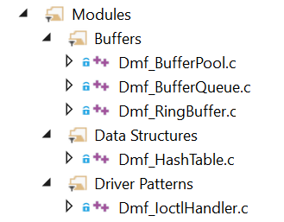
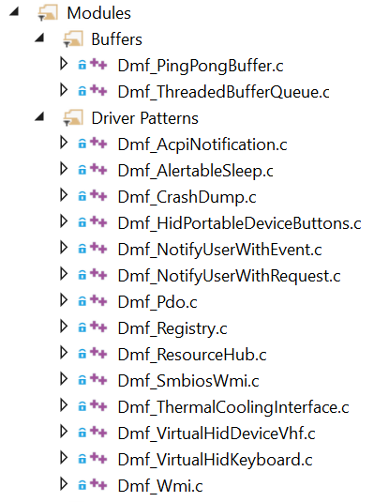
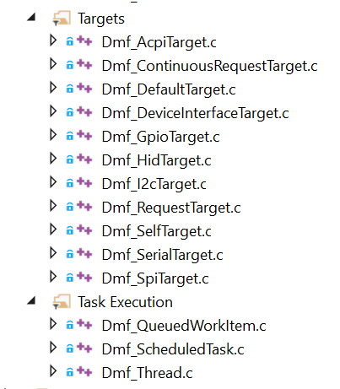
Modules in Library
Goal: Make it easier for driver writers to think using high-level constructs.
Notes:
Once we have the ability to write pure object-oriented code inside drivers ware limited only by our imagination. This is where it gets fun!
Here are many of the Modules released with DMF. Most of these Modules are high level common device driver coding patterns.
Let me point out a few of them:
BufferPool is used by many Modules. It provides a list of pre-allocated buffers and has other features. One very important feature is that it performs bounds checking on the buffers whenever its APIs touch the buffers. It means any Module that uses BufferPool gets bounds checking for free. I think we can all agree that is a useful feature.

Slide 19
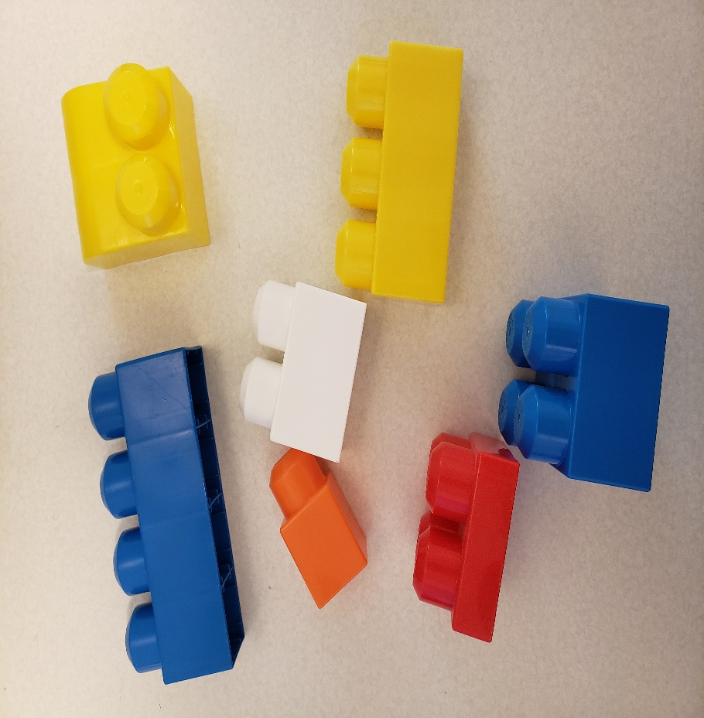
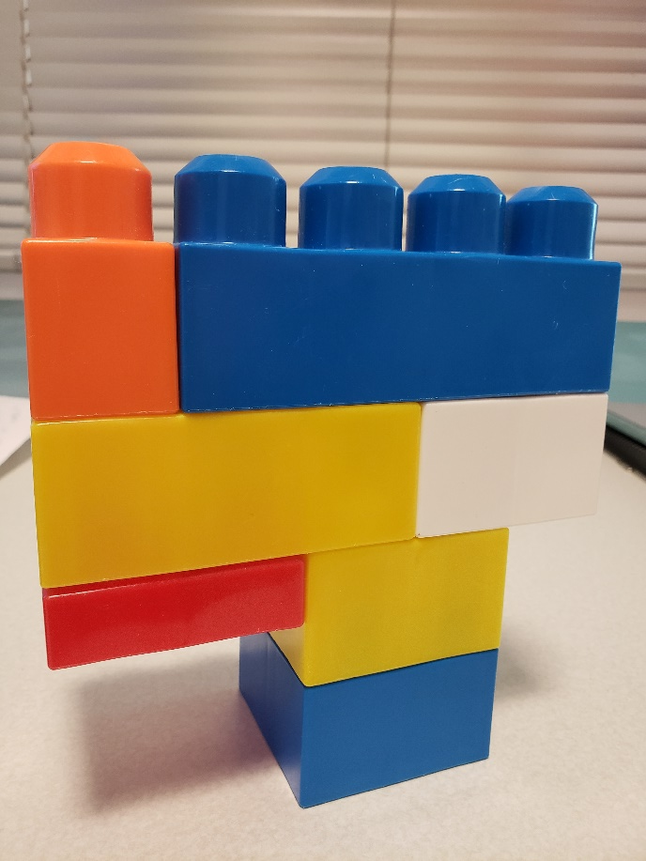
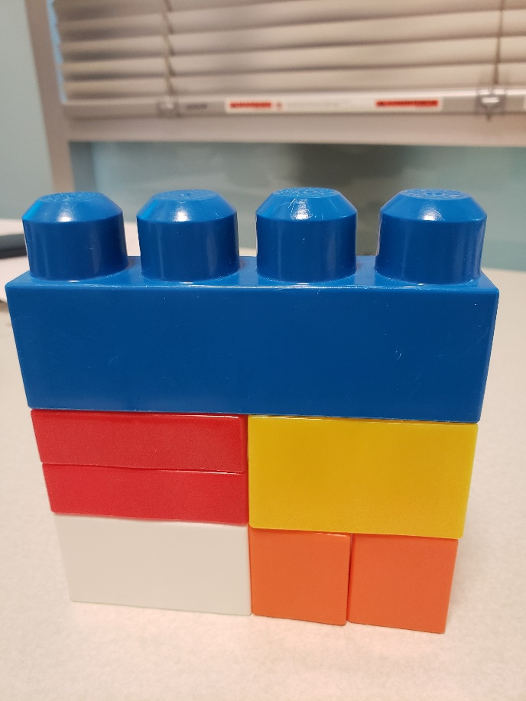
Modules have a Common Interface
Module’s Create Function is called by DMF
Create() function is agnostic regardless of Module type so any Module can use any other Module.
Goal: Make it easier for driver writers to create their own high-level constructs and let others reuse them.
Notes:
Modules perform many diverse functions, but they all have a common create function. This allows DMF to create Module’s on behalf of the Client and allows DMF to manage the lifetime of Modules.
Like Lego blocks Modules can be combined in different ways to create other bigger Modules…Those Modules, in turn, can be used to create even bigger Modules. Again, you are limited only by the memory in the computer and your imagination.
The fact of the matter is, like Lego blocks, Modules are fun to build! It is very satisfying to know that your code can be easily reused.

Slide 20
Module Hierarchy Example
“DMF_GpuInterfaceTarget”
DMF_DeviceInterfaceTarget
DMF_DefaultTarget
DMF_ContinuousRequestTarget
DMF_RequestTarget
DMF_BufferQueue
DMF_QueuedWorkItem
DMF_BufferPool
DMF_QueuedWorkItem
DMF_BufferPool (2)
Goal: Make it easier and more intuitive to write modular, layered code inside drivers.
Notes:
We have seen an example using Legos. Here is an actual tree of two Modules, DeviceInterfaceTarget and DefaultTarget.
DeviceInterfaceTarget uses a given GUID to find an underlying WDFIOTARGET. Then, it uses ContinuousRequestTarget and RequestTarget to provide Methods that allow the Client to send several kinds of requests. DefaultTarget does the same, except it just attaches to the next WDFIOTARGET in the stack.
Suppose that a Client wants to make a new Module called “GPU Device Interface”. It knows the device interface GUID and provide specific Methods that that GPU interface supports. In that case, the Client can just instantiate GPU interface and use its Methods without even knowing the GUID. Here we see a good example of the power of modular, layered code.

Slide 21
How to make a DMF Driver?
What makes a normal WDF driver a DMF driver?
A WDF Client driver must call APIs to hook DMF into the Client driver:
DMF_DmfDeviceInitAllocate()
DMF_DmfDeviceInitHookPnpPowerEventCallbacks()
DMF_DmfDeviceInitHookFileObjectConfig()
DMF_DmfDeviceInitHookPowerPolicyEventCallbacks()
DMF_DmfDeviceInitHookQueueConfig() (optional)
DMF_DmfFdoSetFilter(); (optional)
A WDF Client driver must call this API to initialize DMF.
DMF_ModulesCreate()
The Client driver receives one additional callback where the list of Modules the driver uses is given to DMF.
Notes:
Here I explain how a driver can use DMF. As I explained before, DMF needs to be hooked in between WDF and the Client driver. The Client driver makes this happen by calling the 4 or 5 functions listed above.
Next, the Client driver must cause DMF to start.
Finally, DMF calls into the Client driver to get the list of Modules to instantiate. We will see this in source code in a minute.

Slide 22
How to use a Module
You need two things:
The Module’s CONFIG structure.
The Module’s Methods.
Every Module has a .md File
This file contains documentation about the purpose of the Module, its CONFIG, structures, enumerations, callbacks and Methods.
Notes:
Using a Module is easy. As with WDFOBJECTS, all you need is the Module’s name, Config and list of Methods. These are listed in the Module’s .h file and the Module’s .md file.
Every Module has an .md file which explains the purpose of the Module along with all its methods and related data structures.

Slide 23
DMF Sample Code Tour
Enough theory…Let’s look at code!
There are several samples on Github. Many of the samples use the OSR USB FX2 board because it is accessible and well known.
(Detailed information about the OSR USB FX2 board is available in the MSDN device driver samples repository.)

Slide 24
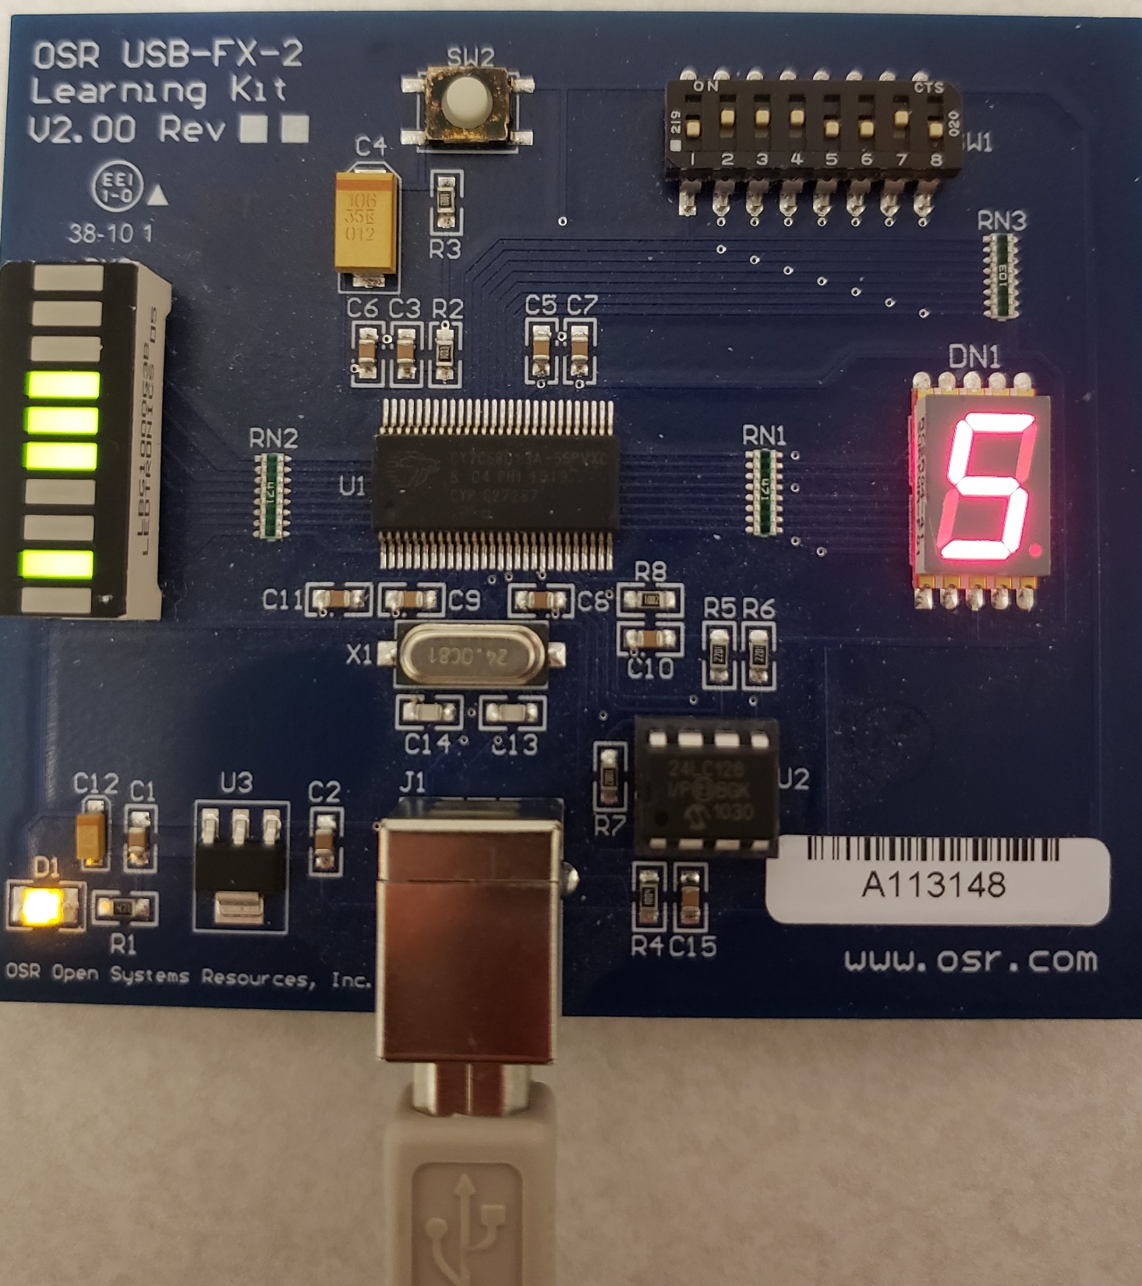
The board has a bank of 8 switches, a bank of lights, a button and an LED segment display. A sample function driver for the board is provided on MSDN. The driver exposes a device interface and IOCTL codes that allow an application to control the lights on the lightbar as well as get notification that the switches have changed and what the switches are set to (on/off). Using the application a user can read the switches and set the lights.
Notes:
The board has a set of switches and lights. The original function driver is provided on MSDN samples along with an example that sends IOCTL codes to read the switch and set the lights.
Our sample driver communicates with that function driver and does following:
Make sure the lights reflect the state of the switches when the board is plugged in.
When the user changes the switch, the lights change to match.

Slide 25

SwitchBar4 (Filter Driver)
SwitchBar4 (Filter Driver)
IOCTL_OSRUSBFX2_GET_INTERRUPT_MESSAGE
IOCTL_OSRUSBFX2_READ_SWITCHES
IOCTL_OSRUSBFX2_SET_BAR_GRAPH_DISPLAY
OSR FX2 Function Driver
Notes:
One way to accomplish the goal is to write a filter driver that sits on the function driver. The filter driver will send an IOCTL to the board that will be completed when the switch is changed. When, that happens the switch is read and the lights are set to match. Also, in D0Entry() of the driver, the switches must be read and lights set to match.

Slide 26
SwitchBar4 Sample
High Level Tasks for New Driver
When D0Entry() occurs read the state of switches and set lights to match.
Send IOCTL requests that are completed every time the switches are changed.
Every time switches are changed, the driver should read the state, convert the bit mask and set the lights to match.

Slide 27
Initializing DMF in a Client Driver (1)
NTSTATUS MyDriver_DeviceAdd(PDEVICEINIT DeviceInit){
NTSTATUS ntStatus; WDFDEVICE device; PDMFDEVICE_INIT dmfDeviceInit;
DMF_EVENT_CALLBACKS dmfCallbacks;
WDF_OBJECT_ATTRIBUTES objectAttributes; WDF_PNPPOWER_EVENT_CALLBACKS pnpPowerCallbacks;
dmfDeviceInit = DMF_DmfDeviceInitAllocate(DeviceInit);
WDF_PNPPOWER_EVENT_CALLBACKS_INIT(&pnpPowerCallbacks);
pnpPowerCallbacks.EvtDeviceD0Entry = SwitchBarEvtDeviceD0Entry;
DMF_DmfDeviceInitHookPnpPowerEventCallbacks(dmfDeviceInit, &pnpPowerCallbacks);
WdfDeviceInitSetPnpPowerEventCallbacks(DeviceInit, &pnpPowerCallbacks);
DMF_DmfDeviceInitHookFileObjectConfig(dmfDeviceInit, NULL);
DMF_DmfDeviceInitHookPowerPolicyEventCallbacks(dmfDeviceInit, NULL);
WdfDeviceInitSetDeviceType(DeviceInit, FILE_DEVICE_UNKNOWN);
WdfDeviceInitSetExclusive(DeviceInit, FALSE);
WdfFdoInitSetFilter(DeviceInit);
DMF_DmfFdoSetFilter(dmfDeviceInit);
WDF_OBJECT_ATTRIBUTES_INIT_CONTEXT_TYPE(&objectAttributes, DEVICE_CONTEXT);
ntStatus = WdfDeviceCreate(DeviceInit, &ObjectAttributes, &device); { if (!NT_SUCCESS(ntStatus) goto Exit; }
dmfCallbacks.EvtDmfDeviceModulesAdd = DmfDeviceModulesAdd;
DMF_DmfDeviceInitSetEventCallbacks(dmfDeviceInit, &dmfCallbacks);
ntStatus = DMF_ModulesCreate(device, &dmfDeviceInit);
Exit:
if (dmfDeviceInit != NULL) DMF_DmfDeviceInitFree(&dmfDeviceInit);
return ntStatus; }
Notes:
This slide shows how to initialize DMF in a Client driver, in this case a filter driver.
With DMF all existing WDF concepts apply. You do not need to unlearn anything. To enable DMF, it needs to intercept all communication between the Client driver and WDF. The highlighted calls show how to do so.

Slide 28
Initializing DMF in a Client Driver (2)
NTSTATUS MyDriver_DeviceAdd(PDEVICEINIT DeviceInit){
NTSTATUS ntStatus; WDFDEVICE device; PDMFDEVICE_INIT dmfDeviceInit;
DMF_EVENT_CALLBACKS dmfCallbacks;
WDF_OBJECT_ATTRIBUTES objectAttributes; WDF_PNPPOWER_EVENT_CALLBACKS pnpPowerCallbacks;
dmfDeviceInit = DMF_DmfDeviceInitAllocate(DeviceInit);
WDF_PNPPOWER_EVENT_CALLBACKS_INIT(&pnpPowerCallbacks);
pnpPowerCallbacks.EvtDeviceD0Entry = SwitchBarEvtDeviceD0Entry;
DMF_DmfDeviceInitHookPnpPowerEventCallbacks(dmfDeviceInit, &pnpPowerCallbacks);
WdfDeviceInitSetPnpPowerEventCallbacks(DeviceInit, &pnpPowerCallbacks);
DMF_DmfDeviceInitHookFileObjectConfig(dmfDeviceInit, NULL);
DMF_DmfDeviceInitHookPowerPolicyEventCallbacks(dmfDeviceInit, NULL);
WdfDeviceInitSetDeviceType(DeviceInit, FILE_DEVICE_UNKNOWN);
WdfDeviceInitSetExclusive(DeviceInit, FALSE);
WdfFdoInitSetFilter(DeviceInit);
DMF_DmfFdoSetFilter(dmfDeviceInit);
WDF_OBJECT_ATTRIBUTES_INIT_CONTEXT_TYPE(&objectAttributes, DEVICE_CONTEXT);
ntStatus = WdfDeviceCreate(DeviceInit, &ObjectAttributes, &device); { if (!NT_SUCCESS(ntStatus) goto Exit; }
dmfCallbacks.EvtDmfDeviceModulesAdd = DmfDeviceModulesAdd;
DMF_DmfDeviceInitSetEventCallbacks(dmfDeviceInit, &dmfCallbacks);
ntStatus = DMF_ModulesCreate(device, &dmfDeviceInit);
Exit:
if (dmfDeviceInit != NULL) DMF_DmfDeviceInitFree(&dmfDeviceInit);
return ntStatus; }
Notes:
In addition, a new callback called ModulesAdd() is registered. DMF will call this callback to get the list of Modules the Client driver needs to intantiate.

Slide 29
Tell DMF the List of Modules to Use
VOID DmfDeviceModulesAdd(WDFDEVICE Device, PDMFDEVICEINIT DmfDeviceInit) {
DEVICE_CONTEXT* deviceContext = DeviceContextGet(Device);
DMF_MODULE_ATTRIBUTES moduleAttributes;
DMF_CONFIG_DefaultTarget moduleConfigDefaultTarget;
DMF_CONFIG_DefaultTarget_AND_ATTRIBUTES_INIT(&moduleConfigDefaultTarget, &moduleAttributes);
moduleConfigDefaultTarget.ContinuousRequestTargetModuleConfig.BufferCountOutput = 1;
moduleConfigDefaultTarget.ContinuousRequestTargetModuleConfig.BufferOutputSize = sizeof(SWITCH_STATE);
moduleConfigDefaultTarget.ContinuousRequestTargetModuleConfig.ContinuousRequestCount = 1;
moduleConfigDefaultTarget.ContinuousRequestTargetModuleConfig.PoolTypeOutput = NonPagedPoolNx;
moduleConfigDefaultTarget.ContinuousRequestTargetModuleConfig.PurgeAndStartTargetInD0Callbacks = FALSE;
moduleConfigDefaultTarget.ContinuousRequestTargetModuleConfig.ContinuousRequestTargetIoctl = IOCTL_OSRUSBFX2_GET_INTERRUPT_MESSAGE;
moduleConfigDefaultTarget.ContinuousRequestTargetModuleConfig.EvtContinuousRequestTargetBufferOutput = SwitchBarSwitchChangedCallback;
moduleConfigDefaultTarget.ContinuousRequestTargetModuleConfig.RequestType = ContinuousRequestTarget_RequestType_Ioctl;
moduleConfigDefaultTarget.ContinuousRequestTargetModuleConfig.ContinuousRequestTargetMode = ContinuousRequestTarget_Mode_Automatic;
moduleAttributes.PassiveLevel = TRUE;
DMF_DmfModuleAdd(DmfModuleInit, &moduleAttributes, WDF_NO_OBJECT_ATTRIBUTES, &deviceContext->DmfModuleDefaultTarget);
// Add more Modules as needed.
//
}
Notes:
This is the corresponding DmfModulesAdd() callback. In this case, the driver instantiates one Module, DefaultTarget. It gives the driver access to the next driver in the stack. It also provides a ContinuousRequestTarget that this driver uses to send the IOCTL that is returned when the switch is changed.
In this case, when the switch is changed, the function SwitchBarSwtichChangedCallback is called.
This Module is set to execute in PASSIVE_LEVEL so that the driver can synchronously read the switches.
One more thing, note how the handle is saved in the Device Context for later use by the driver.
This function does not fail.
After this function returns, DMF will create the Module tree shown in the next slide. Note that the Client need only to instantiate the Module it needs. The Client knows nothing about the tree of Modules.

Slide 30
SwtichBar4 Module Tree
DMF_DefaultTarget
DMF_ContinuousRequestTarget
DMF_RequestTarget
DMF_BufferQueue
DMF_QueuedWorkItem
DMF_BufferPool
DMF_QueuedWorkItem
DMF_BufferPool (2)
Notes:
This is the Module Tree created by DMF Core.

Slide 31
DMF calling the Client Driver’s D0Entry
NTSTATUS SwitchBarEvtDeviceD0Entry(WDFDEVICE Device, WDF_POWER_DEVICE_STATE PreviousState) {
DEVICE_CONTEXT* deviceContext = DeviceContextGet(Device);
NTSTATUS ntStatus;
// Read the state of switches and initialize lightbar.
//
ntStatus = SwitchBarReadSwitchesAndUpdateLightBar(deviceContext->DmfModuleDefaultTarget);
return ntStatus;
}
Notes:
The next thing happens is that the Client driver’s EvtDeviceD0Entry() callback is called. DMF has already dispatched that callback to the instantiated Modules. Now, the Client has a chance to do what it needs.
As discussed before, it is necessary to read the switches and set the lights to match.

Slide 32
DMF calls Client Driver when Switch is Changed
ContinuousRequestTarget_BufferDisposition
SwitchBarSwitchChangedCallback(
_In_ DMFMODULE DmfModuleDefaultTarget,
_In_reads_(OutputBufferSize) VOID* OutputBuffer,
_In_ size_t OutputBufferSize,
_In_ VOID* ClientBufferContextOutput,
_In_ NTSTATUS CompletionStatus
)
{
ContinuousRequestTarget_BufferDisposition returnValue;
if (!NT_SUCCESS(CompletionStatus)) {
returnValue = ContinuousRequestTarget_BufferDisposition_ContinuousRequestTargetAndStopStreaming;
goto Exit;
}
SwitchBarReadSwitchesAndUpdateLightBar(DmfModuleDefaultTarget);
returnValue = ContinuousRequestTarget_BufferDisposition_ContinuousRequestTargetAndContinueStreaming;
Exit:
return returnValue;
}
Notes:
Every time the switch on board is changed, this function is called. In this case, the switch state is read and lights are set using the same function D0Entry callback used.

Slide 33
Last function in driver. Does the work!
NTSTATUS SwitchBarReadSwitchesAndUpdateLightBar(_In_ DMFMODULE DmfModuleDefaultTarget) {
NTSTATUS ntStatus;
SWITCH_STATE switchData;
ntStatus = DMF_DefaultTarget_SendSynchronously(DmfModuleDefaultTarget,
NULL,
0,
(VOID*)&switchData,
sizeof(SWITCH_STATE),
ContinuousRequestTarget_RequestType_Ioctl,
IOCTL_OSRUSBFX2_READ_SWITCHES,
0,
NULL);
if (! NT_SUCCESS(ntStatus)) goto Exit;
ntStatus = DMF_DefaultTarget_ SendSynchronously(DmfModuleDefaultTarget,
&switchData.SwitchesAsUChar,
sizeof(UCHAR),
NULL,
0,
ContinuousRequestTarget_RequestType_Ioctl,
IOCTL_OSRUSBFX2_SET_BAR_GRAPH_DISPLAY,
0,
NULL);
Exit:
return ntStatus;}
Notes:
This is the last function in the driver. It does the actual work of reading the switch and setting the lights.
Note that it uses DefaultTarget’s Methods to send IOCTLs synchronously.
We have accomplished the goal of writing only high-level code.

Slide 34
SwitchBar2 (Remote Target)
SwitchBar2 (Remote Target)
IOCTL_OSRUSBFX2_GET_INTERRUPT_MESSAGE
IOCTL_OSRUSBFX2_READ_SWITCHES
IOCTL_OSRUSBFX2_SET_BAR_GRAPH_DISPLAY
OSR FX2 Function Driver
Notes:
This is another way to write the same driver. In this case, the driver opens the function driver as a remote target using the Device Interface the function driver has exposed.

Slide 35
Tell DMF the List of Modules to Use
VOID DmfDeviceModulesAdd(_In_ WDFDEVICE Device, _In_ PDMFMODULE_INIT DmfModuleInit) {
DMF_MODULE_ATTRIBUTES moduleAttributes;
DMF_CONFIG_DeviceInterfaceTarget moduleConfigDeviceInterfaceTarget;
DMF_MODULE_EVENT_CALLBACKS moduleEventCallbacks;
DMF_CONFIG_DeviceInterfaceTarget_AND_ATTRIBUTES_INIT(&moduleConfigDeviceInterfaceTarget,
&moduleAttributes);
moduleConfigDeviceInterfaceTarget.DeviceInterfaceTargetGuid = GUID_DEVINTERFACE_OSRUSBFX2;
moduleConfigDeviceInterfaceTarget.ContinuousRequestTargetModuleConfig.BufferCountOutput = 1;
moduleConfigDeviceInterfaceTarget.ContinuousRequestTargetModuleConfig.BufferOutputSize = sizeof(SWITCH_STATE);
moduleConfigDeviceInterfaceTarget.ContinuousRequestTargetModuleConfig.ContinuousRequestCount = 1;
moduleConfigDeviceInterfaceTarget.ContinuousRequestTargetModuleConfig.PoolTypeOutput = NonPagedPoolNx;
moduleConfigDeviceInterfaceTarget.ContinuousRequestTargetModuleConfig.PurgeAndStartTargetInD0Callbacks = FALSE;
moduleConfigDeviceInterfaceTarget.ContinuousRequestTargetModuleConfig.ContinuousRequestTargetIoctl = IOCTL_OSRUSBFX2_GET_INTERRUPT_MESSAGE;
moduleConfigDeviceInterfaceTarget.ContinuousRequestTargetModuleConfig.EvtContinuousRequestTargetBufferOutput = SwitchBarSwitchChangedCallback;
moduleConfigDeviceInterfaceTarget.ContinuousRequestTargetModuleConfig.RequestType = ContinuousRequestTarget_RequestType_Ioctl;
moduleConfigDeviceInterfaceTarget.ContinuousRequestTargetModuleConfig.ContinuousRequestTargetMode = ContinuousRequestTarget_Mode_Automatic;
moduleAttributes.PassiveLevel = TRUE;
DMF_MODULE_ATTRIBUTES_EVENT_CALLBACKS_INIT(&moduleAttributes, &moduleEventCallbacks);
moduleEventCallbacks.EvtModuleOnDeviceNotificationPostOpen = SwitchBar_OnDeviceArrivalNotification;
DMF_DmfModuleAdd(DmfModuleInit,
&moduleAttributes,
WDF_NO_OBJECT_ATTRIBUTES,
NULL);
}
Notes:
Here the driver uses DMF_DeviceInterfaceTarget instead of DMF_DefaultTarget. The GUID of the remote target is supplied.
Note how this driver registers for SwtichBar_OnDeviceArrivalNotification so that it knows when the remote target is available.
Like the previous driver, this driver also registers for notifications when the switch is changed using an IOCTL.

Slide 36
SwtichBar4 Module Tree
DMF_DeviceInterfaceTarget
DMF_ContinuousRequestTarget
DMF_RequestTarget
DMF_BufferQueue
DMF_QueuedWorkItem
DMF_BufferPool
DMF_QueuedWorkItem
DMF_BufferPool (2)
Notes:
This is the Module Tree created by DMF Core for SwitchBar2.

Slide 37
DMF informs Client Remote Target Appears
VOID
SwitchBar_OnDeviceArrivalNotification(
_In_ DMFMODULE DmfModule
)
{
SwitchBarReadSwitchesAndUpdateLightBar(DmfModule);
}
Notes:
This is the code that executes when the remote target appears. Like the previous driver, this driver calls the function that reads the switch and sets the lights.

Slide 38
OSR FX2 DMF Samples
Sample 3
Instantiates the OSR FX2 Module to make a driver that does same as normal WDF driver sample.
In interrupt pipe callback, this driver simply completes the IOCTL_OSRUSBFX2_GET_INTERRUPT_MESSAGE request.
Sample 4
Instantiates the OSR FX2 Module but disables enter/exit Idle and IOCTL handling.
In interrupt pipe callback, this driver reads the state of the switches and creates PDOs that match the number of switches that are on. The PDOs are visible in Device Manager.
This sample replicates “kmdf_enumswitches” sample.
Goal: Make it possible to directly reuse (by linking) driver code without using “copy/paste/modify”.
Notes:
We have seen two drivers that talk to the function driver. We have also made a Module called DMF_OsrFx2. This Module is a complete function driver. Sample 3 is the DMF version of the original function driver.
You may ask, “Sam, what is the purpose of making this driver a Module? Why would I ever reuse this code?” Well, nothing is lost writing the driver as a Module. But when it is a Module it can be easily reused.
In this case, the driver calls back into the client whenever the switch is changed. In sample 3, the driver completes the pending IOCTL, just as the original sample did.
I struggled to find something legitimate to do in order to make a another sample that uses the same DMF_OsrFx2 Module. I happened to be looking at samples and found the “kmdf_enumerswitches sample”. It happens to use the same code in the function driver!
That sample reads the switches every time they are changed and creates a PDO for every switch that is set. It so happens we already have a DMF_Pdo Module that creates and destroys PDOs.

Slide 39
Tell DMF the List of Modules to Use
VOID OsrDmfModulesAdd(_In_ WDFDEVICE Device, _In_ PDMFMODULE_INIT DmfModuleInit) {
DMF_MODULE_ATTRIBUTES moduleAttributes;
DMF_CONFIG_OsrFx2 moduleConfigOsrFx2;
DMF_CONFIG_Pdo moduleConfigPdo;
DMF_CONFIG_QueuedWorkItem moduleConfigQueuedWorkitem;
DEVICE_CONTEXT* pDevContext = GetDeviceContext(Device);
DMF_CONFIG_OsrFx2_AND_ATTRIBUTES_INIT(&moduleConfigOsrFx2, &moduleAttributes);
moduleConfigOsrFx2.InterruptPipeCallback = OsrFx2InterruptPipeCallback;
moduleConfigOsrFx2.EventWriteCallback = OsrFx2_EventWriteCallback;
moduleConfigOsrFx2.Settings = (OsrFx2_Settings_NoEnterIdle | OsrFx2_Settings_NoDeviceInterface);
DMF_DmfModuleAdd(DmfModuleInit, &moduleAttributes, WDF_NO_OBJECT_ATTRIBUTES, &pDevContext->DmfModuleOsrFx2);
DMF_CONFIG_Pdo_AND_ATTRIBUTES_INIT(&moduleConfigPdo, &moduleAttributes);
moduleConfigPdo.InstanceIdFormatString = L"SwitchBit=%d";
DMF_DmfModuleAdd(DmfModuleInit, &moduleAttributes, WDF_NO_OBJECT_ATTRIBUTES, &pDevContext->DmfModulePdo);
DMF_CONFIG_QueuedWorkItem_AND_ATTRIBUTES_INIT(&moduleConfigQueuedWorkitem, &moduleAttributes);
moduleConfigQueuedWorkitem.BufferQueueConfig.SourceSettings.BufferCount = 4;
moduleConfigQueuedWorkitem.BufferQueueConfig.SourceSettings.BufferSize = sizeof(UCHAR);
moduleConfigQueuedWorkitem.BufferQueueConfig.SourceSettings.PoolType = NonPagedPoolNx;
moduleConfigQueuedWorkitem.EvtQueuedWorkitemFunction = OsrFx2QueuedWorkitem;
DMF_DmfModuleAdd(DmfModuleInit, &moduleAttributes, WDF_NO_OBJECT_ATTRIBUTES, &pDevContext->DmfModuleQueuedWorkitem);
}
Notes:
In this case, the Client driver uses 3 Modules:
OsrFx2 to get the state of the switches.
Pdo to create and destroy PDOs.
QueuedWorkItem so that PDOs can be created at PASSIVE_LEVEL.
Note how the Module handles are stored in the device context.

Slide 40
Updates PDOs when Switch is Changed 1
VOID
OsrFx2InterruptPipeCallback(
_In_ DMFMODULE DmfModule,
_In_ UCHAR SwitchState,
_In_ NTSTATUS NtStatus
)
{
WDFDEVICE device;
DEVICE_CONTEXT* pDevContext
device = DMF_ParentDeviceGet(DmfModule);
pDevContext = GetDeviceContext(device);
if (NT_SUCCESS(NtStatus))
{
// Create the PDOs in PASSIVE_LEVEL in a synchronized manner.
//
DMF_QueuedWorkItem_Enqueue(pDevContext->DmfModuleQueuedWorkitem,
&SwitchState,
sizeof(UCHAR));
}
}
Notes:
This is the function that is called when the switches are changed. We need to create and destroy PDOs which can only be done at PASSIVE_LEVEL.
In this case the funciton enqueues a workitem passing the received switch state that was returned by the hardware.
The callback function will receive that data.

Slide 41
Updates PDOs when Switch is Changed 2
ScheduledTask_Result_Type OsrFx2QueuedWorkitem(_In_ DMFMODULE DmfModule, _In_ VOID* ClientBuffer, _In_ VOID* ClientBufferContext ) {
DEVICE_CONTEXT* pDevContext;
WDFDEVICE device;
UCHAR* switchState;
NTSTATUS ntStatus;
WCHAR* hwIds[] = { L"{3030527A-2C4D-4B80-80ED-05B215E23023}\\OSRFX2DMFPDO"};
switchState = (UCHAR*)ClientBuffer;
device = DMF_ParentDeviceGet(DmfModule);
pDevContext = GetDeviceContext(device);
for (ULONG bitIndex = 1; bitIndex <= 0x80; bitIndex <<= 1)
{
if ((*switchState) & bitIndex)
{
// The bit is on. Create the PDO.
//
ntStatus = DMF_Pdo_DevicePlug(pDevContext->DmfModulePdo, hwIds, 1, NULL, 0, L"OsrFx2DmfPdo", bitIndex, NULL);
}
else
{
// The bit is off. Destroy the PDO.
//
ntStatus = DMF_Pdo_DeviceUnplugUsingSerialNumber(pDevContext->DmfModulePdo, bitIndex);
}
}
return ScheduledTask_WorkResult_Success;
}
Notes:
Finally, the workitem callback function executes. The switch state read when this call was enqueued is passed in. The function then creates and/or destroys PDOs based on the state of each bit. Pdo does all the work of actually creating the PDO using a single line of code from the Client driver.

Slide 42
Compare Device Context (non-DMF)
typedef struct _BUTTON_INFO
{
BYTE Id;
GPIO_LEVEL GPIOLevel;
}BUTTON_INFO, *PBUTTON_INFO;
typedef struct _RING_BUFF{
PLONG_A32 Round;
ULONG Size;
PBUTTON_INFO pButtonInfo;
ULONG RdPtr;
ULONG WrPtr;
WDFWAITLOCK RBReadLock;
WDFWAITLOCK RBWriteLock;
}RING_BUFF, *PRING_BUFF;
typedef struct _INTERRUPT_CONTEXT {
BYTE ButtonIndex;
PDEVICE_CONTEXT DeviceContext;
} INTERRUPT_CONTEXT, *PINTERRUPT_CONTEXT;
typedef struct _WORKITEM_CONTEXT {
BYTE ButtonIndex;
WDFREQUEST Request;
UINT8* auBuff;
WDFMEMORY ioctlMemory;
DWORD btnMsgcount[GPIO_SLATE_BUTTON_COUNT];
} WORKITEM_CONTEXT, *PWORKITEM_CONTEXT;
typedef struct _WORKITEM_FIRSTSAMPLEOFGPIO_CONTEXT {
PRING_BUFF rbuf;
WDFWAITLOCK WaitLockFirstSample;
__declspec(align(4)) UINT8 uData1;
}WORKITEM_FIRSTSAMPLEOFGPIO_CONTEXT, *PWORKITEM_FIRSTSAMPLEOFGPIO_CONTEXT;
WDF_DECLARE_CONTEXT_TYPE_WITH_NAME(WORKITEM_FIRSTSAMPLEOFGPIO_CONTEXT, GetWorkItemFirstSampleOfButtonGPIO);
typedef struct _WORKITEM_TIMERSAMPLEOFGPIO_CONTEXT {
ULONG TimerElapsed[GPIO_SLATE_BUTTON_COUNT];
WDFWAITLOCK WaitLockTimerSample;
__declspec(align(4)) UINT8 uData2;
}WORKITEM_TIMERSAMPLEOFGPIO_CONTEXT, *PWORKITEM_TIMERSAMPLEOFGPIO_CONTEXT;
WDF_DECLARE_CONTEXT_TYPE_WITH_NAME(WORKITEM_TIMERSAMPLEOFGPIO_CONTEXT, GetWorkItemTimerSampleOfButtonGPIO);
typedef struct _DEVICE_CONTEXT
{
WDFDEVICE wdsBtnDevice;
CM_PARTIAL_RESOURCE_DESCRIPTOR SpbConnection;
LARGE_INTEGER SpbPeripheralId;
LARGE_INTEGER GpioIoPeripheralId[GPIO_SLATE_BUTTON_COUNT];
WDFIOTARGET wdsGpioIoButton[GPIO_SLATE_BUTTON_COUNT];
WDF_INTERRUPT_POLARITY InterruptPolarity[GPIO_SLATE_BUTTON_COUNT];
WDFWORKITEM WorkItemInjectButton;
WDFWAITLOCK WorkItemWaitLock;
WDFWORKITEM WorkItemFirstSampleOfButtonGPIO;
WDFWORKITEM WorkItemTimerSampleOfButtonGPIO;
WDFTIMER SampleButtonGpioWdfTimer[GPIO_SLATE_BUTTON_COUNT];
WDFIOTARGET msgpioWin32;
PVOID msgpioDevExtn;
PFILE_OBJECT msgpioFileObject;
PVOID NotificationHandle; // Interface notification handle
BOOLEAN fMsgpioWriteIoAvailable;
WDFIOTARGET IoTargetToOurself;
UINT8 buttonState[GPIO_SLATE_BUTTON_COUNT];
PRING_BUFF rb;
WDFKEY keyObject;
} DEVICE_CONTEXT, *PDEVICE_CONTEXT;

Slide 43
Compare Device Context (DMF)
typedef struct
{
UCHAR ButtonOverrideKeys[BUTTON_OVERRIDE_DATA_SIZE]; ULONG ButtonOverrideKeysLength;
} BUTTON_OVERRIDE;
typedef struct _DEVICE_CONTEXT
{
WDFDEVICE WdfDevice;
WDFSPINLOCK ButtonStateLock;
ButtonStateType ButtonState[ButtonIdMaximum];
BOOLEAN ThrowAwayPowerButtonUp;
ULONG PowerDownAlreadySent;
ULONG TouchLockEnabled;
BOOLEAN DebounceLongEnoughForValidButtonPress;
BOOLEAN WaitingForPowerDoubleClick;
BOOLEAN DoubleClickDeferredPowerUp;
WDFTIMER PowerButtonDebounceTimer;
WDFTIMER PowerDoubleClickTimer;
ULONG PowerButtonDebounceTimeoutMs;
ULONG PowerButtonDoubleClickTimeoutMs;
ULONG SurfacePlatformId;
ULONG FeatureFlags;
LONG InConnectedStandby;
PVOID PowerSettingHandleLowPowerEpoch;
BUTTON_OVERRIDE ButtonOverride[ButtonIdMaximum];
BOOLEAN AtLeastOneButtonIsOverriden;
DMFMODULE DmfModuleNotificationAcpi;
DMFMODULE DmfModuleButtonFifo;
DMFMODULE DmfModuleButtonsViaVhf;
DMFMODULE DmfModuleSlateLaptopInjector;
DMFMODULE DmfModuleGpioSlConn;
DMFMODULE DmfModuleGpioButton[NUMBER_OF_GPIO_BUTTONS];
DMFMODULE DmfModuleNotifierViaAcpi;
DMFMODULE DmfModuleHid;
DMFMODULE DmfModuleSamCommunicationViaSsh;
DMFMODULE DmfModuleSamNotificationViaSshKeypad;
DMFMODULE DmfModuleQueuedWorkitem;
DMFMODULE DmfModuleCrashDump;
DMFMODULE DmfModuleKernelUserEvent;
DMFMODULE DmfModuleRegistry;
DMFMODULE DmfModuleVirtualHidKeyboard;
DMFMODULE DmfModuleBranchTrack;
} DEVICE_CONTEXT, *PDEVICE_CONTEXT;

Slide 44
Other Notes about DMF
DMF supports:
Function, Filter, Bus drivers and non-PnP drivers as well as NDIS Class Extensions.
Kernel-mode and User-mode drivers.
C and C++ drivers.
DMF Modules always expose a C interface, but internally can use C++. Some of our User-mode drivers use COM.
DMF developers should always work with DEBUG build as that is DMF’s “Verifier” which uses ASSERT() heavily.
Microsoft Surface Team has used DMF for over three years.
Some of our drivers have as much as 99% code reuse (based on lines of code in Client driver). These drivers consist of 2 or 3 callback functions and the ModulesAdd() function.
Driver with least amount of code reuse still reuses 69%.
Remember: The true power of DMF is that it allows you to build your own Modules!

Slide 45
DMF Resources
Links
Github repository : https://github.com/Microsoft/DMF
Blog post is here : http://aka.ms/DMF
Documentation is here : https://github.com/Microsoft/DMF/tree/master/Dmf/Documentation
Email contacts : dmf-feedback@microsoft.com
Component Firmware Update : http://aka.ms/CFU
I will be available throughout WinHEC for any questions, feedback or more in depth discussion.

Slide 46
Demo
Steps:
Clone DMF Repository
Build DMF
Build Samples
Overview of Repository to show documentation
Note: There are many ways to build DMF, however in the repository only contains .vcxproj files. Soon, we will add two other ways to build:
sources file using legacy DDK.
makefiles (even more legacy)

Slide 47
Part 1 Summary
Goal: Make driver programming easier, faster, cheaper and more satisfying.
Goals of DMF
Spend time writing and debugging new code to solve new problems!
Call to Action
Download the latest release of DMF and build it.
Read the list of available Modules.
Read the samples.
Read the documentation.
Try to use a Module in a driver.
Try to write a Module you need and use it in a driver.
Try to write a whole driver using Modules.
Send us questions and feedback!
Notes:
I think a good case can be made that DMF has accomplished the final goal. If you think that DMF can help you write better drivers more efficiently, look at the DMF Module and documentation on Git hub.
Look at the samples. Then, try to use a Module in a driver. Then, try to write a Module that your driver will use. Then, try to write a whole driver using Modules.
Thank you so much for your time. Pankaj and I will be available at “Ask the Experts” if you have questions.

Slide 48
Part 2
Section Introduction
Modules and Module Libraries
Section Agenda:
Module Libraries
Modules
Module Callbacks
Steps to Create a Module from scratch
Steps to Create a Library from scratch
Static Modules/Dynamic Modules
Protocol/Transport Feature

Slide 49
What is a Module Library?
A Module Library is a collection of Modules
Usually this collection has a common characteristic. Examples include:
They are components of a specific feature.
They are distributed separately to others.
Important: Client drivers link to a Module Library, not individual Modules themselves.
DMF contains a library of Modules
These Modules expose simple, root data structures that are common to all types of drivers.
Module authors can instantiate Modules from that Library to create more complex Modules or different versions of those Modules.
These Modules are used by DMF itself. (Parts of DMF are written using Modules that are automatically loaded as needed by the framework).
This allows us to add features to all Modules automatically in the future without Clients having to specifically instantiate those new Modules to access the new features.
New Module Libraries are usually supersets of the Module Library distributed with DMF.
Example: Surface Team has a Module Library named, “Modules.Surface”, a superset of “Modules.Library”.

Slide 50
Modules
In this section, we discuss how to write Modules.
Modules work like Lego blocks
Regardless of their purpose, Modules have a common interface and a common structure.
Later, we will see many Modules that perform many different functions. Yet, the interface to all them from creation to usage is the same.

Slide 51
Module Files
Modules are composed of 3 files…
DMF_[ModuleName].h
DMF_[ModuleName].c
DMF_[ModuleName].md
…and an optional public header file
DMF_[ModuleName]_Public.h

Slide 52
Module Files
The Module DMF_[ModuleName].h File
This file contains only definitions/declarations that Clients use to interact with the Module:
Enumerations and Structure/Type definitions referenced by CONFIG.
Client callback definitions referenced by CONFIG or Methods.
Module CONFIG.
Declaration of Module Macro that automatically defines functions Clients use to instantiate the Module.
Method Prototypes used by Clients.
Important: Clients do not include this file directly. Instead, Clients include the Library’s include file which includes this file and its dependencies.

Slide 53
Module Files
The Module DMF_[ModuleName].c File
This file contains the implementation of the Module (the Module’s code):
This file has several sections that are always in the same order and have specific types of code.
All sections must be present even if there is no code in that section.
(To simplify, information about each section is now listed on a separate slide.)
Important: Clients do not link to this file directly. Instead, Clients link to the Library’s .lib file which includes this file and its dependencies.

Slide 54
Module Files
The Module DMF_[ModuleName].c File Sections (1):
File header:
Summarizes the Module.
/*++
Copyright (c) Microsoft Corporation. All rights reserved.
Licensed under the MIT license.
Module Name:
Dmf_ContinuousRequestTarget.c
Abstract:
Creates a stream of asynchronous requests to a specific IO Target. Also, there is support
for sending synchronous requests to the same IO Target.
Environment:
Kernel-mode Driver Framework
User-mode Driver Framework
--*/

Slide 55
Module Files
The Module DMF_[ModuleName].c File Sections (2):
DMF Includes:
DMF Core APIs, specific to Modules.
Library include file
WPP tracing definitions
// DMF and this Module's Library specific definitions.
//
#include "DmfModule.h"
#include "DmfModules.Library.h"
#include "DmfModules.Library.Trace.h"
#include "Dmf_ContinuousRequestTarget.tmh"

Slide 56
Module Files
The Module DMF_[ModuleName].c File Sections (3):
Definitions and include files used by Module’s (Private) Context:
///////////////////////////////////////////////////////////////////////////////////////////////////////
// Module Private Enumerations and Structures
///////////////////////////////////////////////////////////////////////////////////////////////////////
//

Slide 57
Module Files
The Module DMF_[ModuleName].c File Sections (4):
Module’s Context and Macros:
Module Context (similar to a WDF Driver’s Device Context)
Private to this Module
Contains data structures used by the Module.
Contains handles to Child Modules as needed.
Must be locked in cases where multiple asynchronous calls are possible.
Module Context and CONFIG macros.
Module’s Memory Tag.
///////////////////////////////////////////////////////////////////////////////////////////////////////
// Module Private Context
///////////////////////////////////////////////////////////////////////////////////////////////////////
//

Slide 58
Module Files
The Module DMF_[ModuleName].c File Sections (5):
Module Support Code
Contains any include files not already included by DMF that are needed by this Module.
Contains all the Module’s private Code. These are all static functions.
///////////////////////////////////////////////////////////////////////////////////////////////////////
// DMF Module Support Code
///////////////////////////////////////////////////////////////////////////////////////////////////////
//

Slide 59
Module Files
The Module DMF_[ModuleName].c File Sections (6):
Module’s WDF Callbacks
Contains all the WDF callbacks the Module supports.
These are called automatically, as needed, by DMF.
Note: Function signatures are similar, but not identical, to the corresponding WDF callbacks because the first parameter is DMFMODULE.
///////////////////////////////////////////////////////////////////////////////////////////////////////
// WDF Module Callbacks
///////////////////////////////////////////////////////////////////////////////////////////////////////
//

Slide 60
Module Files
The Module DMF_[ModuleName].c File Sections (7):
Module’s DMF Callbacks
Contains all the DMF callbacks the Module supports.
These are called automatically, as needed, by DMF.
Separate slides will discuss each of them.
///////////////////////////////////////////////////////////////////////////////////////////////////////
// DMF Module Callbacks
///////////////////////////////////////////////////////////////////////////////////////////////////////
//

Slide 61
Module Files
The Module DMF_[ModuleName].c File Sections (8):
Module’s Descriptor declarations.
These are global buffers for descriptors are used by the Module.
They are initialized and used by Module’s Create callback as well as Module Methods.
///////////////////////////////////////////////////////////////////////////////////////////////////////
// DMF Module Descriptor
///////////////////////////////////////////////////////////////////////////////////////////////////////
//
static DMF_MODULE_DESCRIPTOR DmfModuleDescriptor_ContinuousRequestTarget;
static DMF_CALLBACKS_WDF DmfCallbacksWdf_ContinuousRequestTarget;
static DMF_CALLBACKS_DMF DmfCallbacksDmf_ContinuousRequestTarget;

Slide 62
Module Files
The Module DMF_[ModuleName].c File Sections (9):
Module’s publicly accessible functions:
Contains Module’s Create function. (Discussed in a separate slide.)
Contains Module’s Methods. (These have declarations in the Module’s .h file).
///////////////////////////////////////////////////////////////////////////////////////////////////////
// Public Calls by Client
///////////////////////////////////////////////////////////////////////////////////////////////////////
//

Slide 63
Module Files
The Module DMF_[ModuleName]_Public.h File
Contains definitions that User-mode applications and/or other drivers use to communicate with the Module
Examples:
Device Interface GUID
IOCTL definitions
Enumerations and Structures used in IOCTL calls
Important: It must be possible to compile this file using only the Win32 SDK or DDK. It must not contain any references to DMF or DMFMODULE or any DMF construct.

Slide 64
Module Files
The Module DMF_[ModuleName].md File
Contains detailed documentation for the Module.
This file has a specific format and is divided into sections similar to a Module’s .c file.
Use this file to understand the purpose of the Module and how to instantiate it and use its Methods.
This file encourages the Module’s programmer to write documentation. That documentation never needs to be written again by a user of the Module.

Slide 65
DMF Module Callbacks
There are 3 kinds of callbacks
DMF/WDF callbacks
Called by DMF either for Module’s lifetime management or because WDF has called into the driver.
Direct Callbacks to Module’s Parent
Called directly by the underlying Modules.
Indirect Callbacks from Child Modules (*)
Called from Child Module that is not an immediate child. (Grand-child).

Slide 66
DMF Module Callbacks
Module Callbacks called by DMF.
All DMF/WDF callbacks receive DMFMODULE (this Module’s handle).
WDF Callbacks also receive additional parameters passed by WDF.
Use DMF_CONFIG_GET(DmfModule) to retrieve the Module’s Config data.
Use DMF_CONTEXT_GET(DmfModule) to retrieve the Module’s Context.
Use DMF_ModuleLock(DmfModule) and DMF_ModuleUnlock(DmfModule) to lock and unlock the Module’s Context when necessary.

Slide 67
DMF Module Callbacks
Module Callbacks called by Modules (Direct)
These callbacks receive the caller’s DMFMODULE when called by a Module.
(Similar to how WDFTIMER’s Timer callback works.)
Use DMF_ParentModuleGet(DmfModule) to get its Parent Module or DMF_ParentDeviceGet(DmfModule) to get its Parent Device.
If callback is part of a Parent Module,
use DMF_CONFIG_GET(ParentDmfModule) to retrieve the passed DMFMODULE’s Config data.
use DMF_CONTEXT_GET(ParentDmfModule) to retrieve the passed DMFMODULE’s Context.
Use DMF_ModuleLock(ParentDmfModule) and DMF_ModuleUnlock(ParentDmfModule) to lock and unlock the Module’s Context when necessary.

Slide 68
DMF Module Callbacks
Module Callbacks called by Modules (Indirect) *
These callbacks receive a WDFDEVICE when called by a Module as wells as an VOID* context.
If Callback is part of a Parent Module,
Use ParentModule = DMF_VOIDTOHANDLE(Context) to get its Parent Module.
Then, use DMF_CONFIG_GET(ParentDmfModule) to retrieve the passed DMFMODULE’s Config data.
Also, use DMF_CONTEXT_GET(ParentDmfModule) to retrieve the passed DMFMODULE’s Context.
Use DMF_ModuleLock(ParentDmfModule) and DMF_ModuleUnlock(ParentDmfModule) to lock and unlock the Module’s Context when necessary.

Slide 69
DMF Module Callbacks
These callbacks are DMF specific
DMF_[ModuleName]_Create()
DMF_[ModuleName]_ChildModulesAdd()
DMF_[ModuleName]_ResourcesAssign()
DMF_[ModuleName]_Open()
DMF_[ModuleName]_Close()
DMF_[ModuleName]_NotificationRegister()
DMF_[ModuleName]_NotificationUnregister()

Slide 70
DMF Module Callbacks
DMF_[ModuleName]_Create()
DMF calls this callback when it needs to create an instance of a Module.
Definition of Create: Create the structures that DMF uses to manage the lifetime and dispatching of messages to the Module.
Module author must populate several descriptors:
WDF callbacks descriptor which tell DMF what WDF callbacks are supported.
DMF callbacks descriptor which tell DMF what DDF callbacks are supported.
Descriptor which defines the Module’s Context and Module’s Config and Module’s synchronization mode.
Call DMF_ModuleCreate() using the above descriptors.

Slide 71
DMF Module Callbacks
DMF_[ModuleName]_ChildModulesAdd()
DMF calls this callback when wants the list of a Parent Module’s Child Modules.
The Module author performs two tasks:
Declare an instance of DMF_MODULE_ATTRIBUTES.
Initializes the unique Config structure and calls DMF_DmfModuleAdd() for every Module that will be a Child Module of the Parent Module. All these Configs are added to a list.
The Modules are not created here. After this callback returns, DMF will call the DMF_[ModuleName]_Create() function of every Module in that list.
In addition, DMF places the Modules in a tree structure for lifetime management and dispatching of WDF callbacks.
There is no limit to the number of Child Modules, nor the depth of the tree except for system memory and stack.

Slide 72
DMF Module Callbacks
DMF_[ModuleName]_ResourcesAssign()
DMF calls this callback so that the Module can find and configure its resources.
In this callback, Modules loop through the available resources and extract configuration information.
That information is used later to configure constructs such as GPIO lines and interrupts.
NOTE: DMF_GpioTarget and DMF_InterruptResource do this automatically for GPIO and Interrupts. Instead of doing that work for those resources, it is better to simply instantiate those Modules.
For example, one might use this callback to get information about the PCI BAR.

Slide 73
DMF Module Callbacks
DMF_[ModuleName]_Open()
DMF calls this callback to allow the Module to initialize its Module Context (which has been automatically allocated).
Here the Module Author may perform tasks such as:
Read parameters from the Module’s Config.
Allocate memory.
Allocate WDF handles to WDF objects such as WDFTIMER.
Create C++ objects and/or other non-C++ structures.
Initialize flags and the above structures for further use.
Important: DMF guarantees that its Child Modules have been opened when this callback executes.

Slide 74
DMF Module Callbacks
DMF_[ModuleName]_Close()
DMF calls this callback to allow the Module to perform the inverse of what it did in DMF_[ModuleName]_Open().
Free all resources allocated in DMF_[ModuleName]_Open().
Important: DMF guarantees that the Parent Module has already been closed, but not its Child Modules, when this callback executes.

Slide 75
DMF Module Callbacks
DMF_[ModuleName]_NotificationRegister()
DMF calls this callback to allow the Module to register for an asynchronous event that must happen before the Module is ready to “open”.
Often, this callback calls IoRegisterPlugPlayNotification().
But there are other uses and ways in which notifications can arrive.
Eventually, usually from the notification callback passed to IoRegisterPlugPlayNotification(), DMF_ModuleOpen() is called.

Slide 76
DMF Module Callbacks
DMF_[ModuleName]_NotificationUnregister()
DMF calls this callback to allow the Module to do the inverse of any actions done in DMF_[ModuleName]_NotificationRegister().
For example, this callback often calls IoUnregisterPlugPlayNotification().
Any resources or handles allocated in DMF_[ModuleName]_NotificationRegister() must be released.

Slide 77
Protocol-Transport Modules
Allows selection of Child and Number of Children at Runtime
Ordinary Modules choose their Child Modules at compile time.
Choosing Modules (and the number of Modules) at run-time provides the ability perform even more code modularization and reusability.
Consider two scenarios in which this mode is helpful:
Power Meter driver.
Load balancing driver.

Slide 78
Protocol-Transport Modules
Power Meter driver using non-Protocol-Transport Modules
Power Meter Service (User Mode)
Client Driver
Power Meter Chip Vendor “A”
Power Meter Module “A”
I2C Bus
Notes:
Classic DMF driver instantiates a Power Meter Module that has a Power Meter Chip Child Module. In turn, it uses the I2C Module.
The Power Meter service talks directly to Power Meter Module via IOCTLs. Power Meter Module converts IOCTLs into Power Meter Chip commands. Power Meter Chip sends the commands to I2C bus.
In this case, using DMF we have clean design with reusability. But we can do better.

Slide 79
Protocol-Transport Modules
Power Meter driver using Protocol-Transport Modules
Power Meter Service (User Mode)
Client Driver
Power Meter Chip Vendor “A”
Power Meter Module
I2C
HID
Power Meter Chip Vendor “B”
USB
Power Meter Chip Vendor “C”
Notes:
Using Protocol-Transport Modules it is possible for the Client driver to select the Chip Vendor and the Bus the Chip resides on at run time. (Client driver reads the registry to determine what is installed.)
Then, the Client Driver instantiates a Power Meter Modules, a Power Meter Chip Vendor Module, and a Bus Module and binds the three Modules together.
The Power Meter Module can talk to any of the Power Meter Chip Vendor Modules via a predefined common interface that is supported by all Power Meter Chip Vendor Modules.
In the same way, it is possible for the Bus Modules to expose a common interface that reads/writes registers that any of the Chip Vendor Modules can use.

Slide 80
Protocol-Transport Modules
Load Balance driver using Protocol-Transport Modules
Transactions Producer
Client Driver
Resource Instance “1”
Load Balance Module (Consumes using “N” instances)
Resource Instance “…”
Resource Instance “N”
Notes:
In this case, consider a scenario where a producer of transactions sends data to a load balancing driver.
The load balancing driver determines at run-time how many resources it has and creates a Child Module for each resource. Also, resources can come and go on-line during run-time.
Using Protocol-Transport Modules it possible for the Load Balance Module to dynamically create a Child Module for each instance.
There different ways in which this problem can be solved. Protocol-Transport Modules provide one way to do so.

Slide 81
Steps to Create A Module
Choose either the DMF_Template Module or an existing Module that is similar to the new Module that is to be created. (This is the Reference Module for purposes of this slide.)
Open all the files associated with the Reference Module: .c, .h., _Public.h, .md. (Note: These should be the only open files, since step 4 does search and replace all open files)
Select each of the open files and “Save as…” the name of the New Module in the directory of the target Module Library.
Search and replace the Reference Module name with the name of the new Module.
Include the target Module’s Library’s .h file at the top of the new Module’s .c file (it is probably set that way already).
Add the new Module’s .h file to the list of Modules in the Module Library’s .h file.
Add the new Module’s files (.c, .h, _Public.h and .md file) to the Module Library’s project file.
(At this point, intellisense should work and it is possible to successfully compile the Module Library with the new Module.)
Modify the Module’s “Support Code” as needed.
Add/delete WDF/DMF callbacks as needed (including adding its necessary Child Modules).

Slide 82
Steps to Create A Module Library
Copy the Solution\DmfKModules.Template directory as the name of the new Library (e.g., DmfKModules.NewLibrary).
Switch to the new directory.
Rename DmfKModules.Template.vcxproj as DmfKModules.NewLibrary.vcxproj.
Rename DmfKModules.Template.vcxproj as DmfKModules.NewLibrary.vcxproj.filters.
Copy the Dmf\Modules.Template directory as the name of the new Library (e.g., Modules.NewLibrary).
Delete all the “Dmf_*.*” files. Keep the DmfModules.Template.* files.
Rename the DmfModules.Template.* files as DmfModules.NewLibrary.*.
Do steps 1 to 4 but use “DmfU” instead of “DmfK” (unless you don’t need a User Mode version of the Library).
Open the DMF Solution in Visual Studio.
Add the DmfKModules.NewLibrary.vcxproj and DmfKModules.NewLibrary.vcxproj.filters to the solution. Do the same for the “DmfU…” files.
Remove all the files from the projects.
Add the DmfModules.NewLibrary.h, Modules.NewLibrary.Public.h and DmfModules.NewLibrary.Trace.h files to both projects.
Open DmfModules.NewLibrary.h and delete the names of all the Module .h files referenced in that file.
Do the same for DmfModules.NewLIbrary.Public.h.
Update the include and link paths to indicate the location the new Library.
Now it is possible to add new Modules to this Library and successfully compile the new Library.

Slide 83
Demo
Steps:
Create a new Module Library
Create a new Module

Slide 84
Part 2 Summary
Sharing Driver Code is Simple in DMF because many mundane technical questions are already answered for you! All you need to do is write the code that is to be shared and debug it. The following questions already have answers:
What directory does the new shared code and header files go?
How should the new shared code be instantiated and used by a Client?
How should the different parts of a new shared code be named?
Where is the new shared code’s private data and private methods be defined?
Where is the new shared code’s public data and public methods be defined?
Where do common Kernel and User-mode definitions go?
Where does the new shared code’s documentation go? What is the format of that documentation?
How to ensure that the new shared code is compatible with external users?
How to make a shared library of shared code?

Slide 85
Part 3
Section Introduction
Review of some Modules distributed with DMF
Section Agenda:
DMF_BufferPool
DMF_BufferQueue
DMF_QueuedWorkitem
DMF_Thread
DMF_ThreadedBufferQueue
DMF_RequestTarget
DMF_ContinuousRequestTarget
DMF_IoctlHandler

Slide 86
DMF_BufferPool
A simple list of pre-allocated buffers of a certain size
Number of buffers can be finite or from a lookaside list.
Each buffer can have its own context.
Module performs bounds checking to check for buffer overrun when buffers are used in Methods. (Debug build only.)
Each buffer has an optional timer which can be used for tasks such as stale data detection or hardware operation timeout.
Makes it easy to uses lists of buffers instead of other simpler but less optimal data structures.

Slide 87
DMF_BufferQueue
Producer-Consumer Buffer Lists
Composed of two instances of DMF_BufferPool.
Producer: It is a list (finite or infinite) of pre-allocated buffers.
Consumer: It is an empty list.
When Client has work to do or some data that needs to be held for a while, the Client “fetches” a buffer from DMF_BufferQueue. (Fetch = Get from Producer list.)
Client writes to the buffer.
Client “enqueues” the buffer in DMF_BufferQueue. (Enqueue = put in Consumer list.)
Later, Client “dequeues” the buffer. (Dequeue = get from Consumer list.)
Client reads data from that buffer and uses it.
Client then “reuses” the buffer. (Reuses = put buffer back into Producer list.)
Because these are DMF_BufferPool buffers, bounds checking comes for free.

Slide 88
DMF_QueuedWorkitem
WDFWORKITEM with call specific context
Allows caller to enqueue a workitem with a call (enqueue) specific context.
WDFWORKITEM has a single context attached to the WDFOBJECT.
But, DMF_QueuedWorkitem’s callback function passes an additional (optional) context that is passed when the workitem is enqueued.
The Module maintains a count of how many pending enqueues remain in case the workitem is enqueued while it is already enqueued.
Thus, the workitem’s callback will execute exactly the number of times the enqueue Method is called. Thus, the Client’s callback function need not worry about knowing how much work needs to be done.
This Module uses DMF_BufferQueue.

Slide 89
DMF_Thread
Creates a thread and manages its operation
This Module creates a thread, a “thread-stop” event and a “work-ready” event.
It contains a loop that waits on the two events.
When the “work-ready” event is set, a Client callback is called where the Client can perform work.
When the “thread-stop” event is set the thread loop ends and the thread stops executing. Module, of course, waits for thread to end properly.

Slide 90
DMF_ThreadedBufferQueue
Allows multiple asynchronous callers to enqueue work that is performed synchronously.
Client
DMF_ThreadedBufferQueue
ThreadedBufferQueue.Fetch
Thread Callback
DMF_Thread
Client writes work
DMF_BufferQueue
ThreadedBufferQueue.Enqueue
DMF_BufferPool (Producer)
Hardware
Client Callback (does work)
DMF_BufferPool (Consumer)
ThreadedBufferQueue.Reuse

Slide 91
DMF_RequestTarget
Allows Client to send/receive data to underlying WDFIOTARGET by just sending a buffer instead of creating a WDFREQUEST.
Synchronous/Asynchronous calls are supported.
IOCTL/Read/Write calls are supported.
Target WDFIOTARGET is set by the Client.
This Module is used by other high-level Modules that expose the same functionality for their Clients.

Slide 92
DMF_ContinuousRequestTarget
Allows Client to automatically create, send and receive multiple buffers to a WDFIOTARGET.
This Module is similar to WdfUsbContinuousReader except that this Module works for any WDFIOTARGET.
Client specifies number of buffers and size/type of each buffer. Module automatically allocates memory and WDFREQUESTS and sends them to the WDFIOTARGET specified by the Client.
Client specifies Input Buffer Callback so that the Client can populate buffers prior to being sent.
Client specifies Output Buffer Callback so that the Client can extract data from buffers after the WDFIOTARGET completes them. Afterward, Module automatically sends them back to the WDFIOTARGET.
The Module implements proper rundown logic when it is time to stop sending buffers.
This Module is also used by high-level Modules that expose this functionality for their Clients.

Slide 93
DMF_IoctlHandler
Given a table of each supported IOCTL along with the appropriate minimum input/output buffer sizes, this Module automatically validates IOCTLs that arrive.
There is an option to also validate if the caller is running “As Administrator”.
Also, there is an option for Client control of access based on file handle.
After the Module validates the IOCTL, its input/output buffers are extracted and presented to the Client in a callback function.
Client just needs to use the buffers as needed.
Client returns STATUS_PENDING to retain the buffers (and WDFREQUEST). Otherwise, the Module will automatically complete the WDFREQUEST on behalf of the Client using the NTSTATUS the Client returns from the callback.

Slide 94
Modules in Library
Goal: Make it easier for driver writers to think using high-level constructs.

Slide 95
Part 3 Summary
This section has shown how small, simple Modules are used to build bigger, more complex Modules. In turn, those Modules can be used to build even bigger, more complex Modules, and so on and so on…
One can see how each Module is its own self-contained layer. It only worries about its own tasks and code.
As stated before, Modules are like Lego pieces.
It is up to you and your imagination how to combine Modules.
It is up to you and your imagination what Module you write.
A Module can be an entire driver. Even that Module can become a Child of another Module.
If you do not like how a Module is implemented, you can write your own version.
If you need to add a Method to a Module, you can do so.

Slide 96
Part 4
Section Introduction
Review of Surface Modules and drivers that use DMF
Section Agenda:
Surface Library Modules Overview
SurfaceButton
SurfaceAcpiNotify
SurfaceIntegrationDriver
SurfaceSarManager
Notes:
I will discuss how to use DMF in drivers and show sample source code.
I will discuss our plans with DMF going forward and show you where you can get DMF.
Everything I talk about today, including DMF itself, the Modules, and sample code are all available as source on Git hub and you can download it now.

Slide 97
Part 4 Summary
Surface Team uses DMF for all new drivers…
We have written 95 Modules, 39 of which are publicly distributed with DMF.
Our Modules and drivers that use them work in various environments.
User-mode Modules even use COM and Lambdas as well as very high-level APIs.
Sound engineering practices coupled with tools, guard against regressions and build breaks due to code sharing.
DMF is the go to framework for all new Driver development tasks.
We believe the same will happen in your teams. ☺
Regardless, we continue to improve DMF based on feedback as well as our usage needs.

Slide 98
Plans for going forward
DMF is Open Source
Want to be a DMF Contributor? Simply create a pull request on Github.
Found an issue in DMF? Open a bug in the Git repository’s bug database.
We have been updating the code base frequently and will continue to do so.
We are adding more samples, especially more complex samples.
We are adding more Modules to the Library.
DMF is not officially supported by Microsoft as a product. DMF is not supported by Customer Support Services.

Slide 99
Thank you!
Thank you for hosting us and listening to us!
Happy Coding. Looking forward to your contributions to DMF.
If you have questions, please contact us: dmf-feedback@microsoft.com
We are making improvements rapidly based on your valuable feedback.
Notes:
I think a good case can be made that DMF has accomplished the final goal. If you think that DMF can help you write better drivers more efficiently, look at the DMF Module and documentation on Git hub.
Look at the samples. Then, try to use a Module in a driver. Then, try to write a Module that your driver will use. Then, try to write a whole driver using Modules.
Thank you so much for your time. Pankaj and I will be available at “Ask the Experts” if you have questions.

